Slide 1
CCENT Study Guide
Chapter 11
VLANs and Inter-VLAN Routing

Slide 2
Chapter 11 Objectives
The CCENT Topics Covered in this chapter include:
2.0 LAN Switching Technologies
2.4 Configure, verify, and troubleshoot VLANs (normal range)
spanning multiple switches.
2.4.a Access ports (data and voice)
2.4.b Default VLAN
2.5 Configure, verify, and troubleshoot interswitch
connectivity.
2.5.a Trunk ports
2.5.b 802.1Q
2.5.c Native VLAN
3.0 Routing Technologies
3.4 Configure, verify, and troubleshoot inter-VLAN routing.
3.4.a Router on a stick
2

Slide 3
Figure 11.1: Flat network structure
With this configuration, every broadcast packet transmitted is seen by every device on the network regardless of whether the device needs to receive that data or not.

Slide 4
Figure 11.2: The benefit of a switched network
Figure 11.2 pictures a switched network and shows Host A sending a frame with Host D as its destination. Clearly, the important factor here is that the frame is only forwarded out the port where Host D is located.

Slide 5
Figure 11.3: One switch, one LAN: Before VLANs, there was no separation between hosts.
Figure 11.3 shows all hosts in this very small company connected to one switch, meaning all hosts will receive all frames, which is the default behavior of all switches.

Slide 6
Figure 11.4: One switch, two virtual LANs (logical separation between hosts): Still physically one switch, but this switch acts as many separate devices.
In Figure 11.4, I configured the switch to be two separate LANs, two subnets, two broadcast domains, two VLANs—they all mean the same thing—without buying another switch.

Slide 7
Figure 11.5: Access ports
Access ports
An access port belongs to and carries the traffic of only one VLAN. Traffic is both received and sent in native formats with no VLAN information (tagging) whatsoever. Anything arriving on an access port is simply assumed to belong to the VLAN assigned to the port. Because an access port doesn’t look at the source address, tagged traffic—a frame with added VLAN information—can be correctly forwarded and received only on trunk ports.

Slide 8
Access Ports
An access port belongs to and carries the traffic of only one VLAN.
Because an access port doesn’t look at the source address, a frame with added VLAN information—can be correctly forwarded and received only on trunk ports.
Any device attached to an access link is unaware of a VLAN membership—the device just assumes it’s part of some broadcast domain.
You can only create a switch port to be either an access port or a trunk port—not both.
a physical port belongs to only one VLAN if it’s an access port or all VLANs if it’s a trunk port.

Slide 9

Figure 11.6: VLANs can span across multiple switches by using trunk links, which carry traffic for multiple VLANs.
Trunk ports
A trunk link is a 100, 1000, or 10000 Mbps point-to-point link between two switches, between a switch and router, or even between a switch and server, and it carries the traffic of multiple VLANs—from 1 to 4,094 VLANs at a time. But the amount is really only up to 1,001 unless you’re going with something called extended VLANs.
Trunk Link
SALES
Admin
Access Port
SALES
Admin
Notes:
But the amount is really only up to 1,001 unless you’re going with something called extended VLANs.

Slide 10
Frame Tagging
This frame identification method uniquely assigns a user-defined VLAN ID to each frame.
Here’s how it works: Once within the switch fabric, each switch that the frame reaches must first identify the VLAN ID from the frame tag. It then finds out what to do with the frame by looking at the information in the filter table.
If the frame reaches a switch that has another trunked link, the frame will be forwarded out of the trunk-link port.
Once the frame reaches an exit that’s determined by the forward/filter table to be an access link matching the frame’s VLAN ID, the switch will remove the VLAN identifier.
This is so the destination device can receive the frames without being required to understand their VLAN identification information.

Slide 11
VLAN Identification Methods
Inter-Switch Link (ISL)
a way of explicitly tagging VLAN information onto an Ethernet frame.
This allows the switch to identify the VLAN membership of a frame received over the trunked link.
IEEE 802.1q
Created by the IEEE as a standard method of frame tagging, IEEE 802.1q actually inserts a field into the frame to identify the VLAN.

Slide 12
Figure 11.7: IEEE 802.1q encapsulation with and without the 802.1q tag
Preamble (7-bytes) | Start Frame Delimiter (1-byte) | Destination MAC Address (6-bytes) | Source MAC Address (6-bytes) | Type/Length (2-bytes) | Packet (0 – n bytes) | Pad (0 – p bytes) | Frame Check Sequence (4-bytes)
Preamble (7-bytes) | Start Frame Delimiter (1-byte) | Destination MAC Address (6-bytes) | Source MAC Address (6-bytes) | Type/Length = 802.1Q Tag Type (2-bytes) | Tag Control Information | Length/Type (2-Bytes) | Packet (0 – n bytes) | Pad (0 – p bytes) | Frame Check Sequence (4-bytes)
802.1q Field
inserted
CRC must be recalculated
3 bits = User priority field
1 bit = Canonical Format Identifier (CFI)
12 bits – VLAN Identifier (VLAN ID)
Created by the IEEE as a standard method of frame tagging, IEEE 802.1q actually inserts a field into the frame to identify the VLAN.

Slide 13
Figure 11.8: Router connecting three VLANs together for inter-VLAN communication, one router interface for each VLAN
What we see in Figure 11.8 is that each router interface is plugged into an access link. This means that each of the routers’ interface IP addresses would then become the default gateway address for each host in each respective VLAN.

Slide 14
Figure 11.9: “Router on a stick”: Single router interface connecting all three VLANs together for inter-VLAN communication
Instead of using a router interface for each VLAN, you can use one FastEthernet interface and run ISL or 802.1q trunking. Figure 11.9 shows how a FastEthernet interface on a router will look when configured with ISL or 802.1q trunking. This allows all VLANs to communicate through one interface. Cisco calls this a “router on a stick (ROAS).”

Slide 15

Figure 11.10: A router creates logical interfaces.
GigabitEthernet 0/0.1
GigabitEthernet 0/0.2
GigabitEthernet 0/0.3
GigabitEthernet 0/0
Figure 11.10 shows how we would create a router on a stick using a router’s physical interface by creating logical interfaces—one for each VLAN.

Slide 16
Figure 11.11: With IVR, routing runs on the backplane of the switch, and it appears to the hosts that a router is present.
VLAN 10
VLAN 20
I’m Virtual!
VLAN 10
VLAN 20
3560
Instead of using an external router interface for each VLAN, or an external router on a stick, we can configure logical interfaces on the backplane of the layer 3 switch; this is called inter-VLAN routing (IVR).

Slide 17
Creating VLANs
S1(config)#vlan ?
WORD ISL VLAN IDs 1-4094
access-map Create vlan access-map or enter vlan access-map command mode
dot1q dot1q parameters
filter Apply a VLAN Map
group Create a vlan group
internal internal VLAN
S1(config)#vlan 2
S1(config-vlan)#name Sales
S1(config-vlan)#vlan 3
S1(config-vlan)#name Marketing
S1(config-vlan)#vlan 4
S1(config-vlan)#name Accounting
S1(config-vlan)#^Z
S1#

Slide 18
Viewing Access Ports
Once the VLANs are created, verify your configuration with the show vlan command (sh vlan for short):
S1#sh vlan
VLAN Name Status Ports
---- ------------------------- --------- -------------------------------
1 default active Fa0/1, Fa0/2, Fa0/3, Fa0/4
Fa0/5, Fa0/6, Fa0/7, Fa0/8
Fa0/9, Fa0/10, Fa0/11, Fa0/12
Fa0/13, Fa0/14, Fa0/19, Fa0/20
Fa0/21, Fa0/22, Fa0/23, Gi0/1
Gi0/2
2 Sales active
3 Marketing active
4 Accounting active
[output cut]

Slide 19
View Trunk Ports
S1# show interfaces trunk
Port Mode Encapsulation Status Native vlan
Fa0/15 desirable n-isl trunking 1
Fa0/16 desirable n-isl trunking 1
Fa0/17 desirable n-isl trunking 1
Fa0/18 desirable n-isl trunking 1
Port Vlans allowed on trunk
Fa0/15 1-4094
Fa0/16 1-4094
Fa0/17 1-4094
Fa0/18 1-4094
[output cut]

Slide 20
Configuring Trunk ports
The following switch output shows the trunk configuration on interfaces Fa0/15–18 as set to trunk:
S1(config)#int range f0/15-18
S1(config-if-range)#switchport trunk encapsulation dot1q
S1(config-if-range)#switchport mode trunk
If you have a switch that only runs the 802.1q encapsulation method, then you wouldn’t use the encapsulation command as I did in the preceding output.

Slide 21
Assigning access ports
S3#config t
S3(config)#int fa0/3
S3(config-if)#switchport mode ?
access Set trunking mode to ACCESS unconditionally
dot1q-tunnel set trunking mode to TUNNEL unconditionally
dynamic Set trunking mode to dynamically negotiate access or trunk mode
private-vlan Set private-vlan mode
trunk Set trunking mode to TRUNK unconditionally
S3(config-if)#switchport mode access
S3(config-if)#switchport access vlan 3
By starting with the switchport mode access command, you’re telling the switch that this is a nontrunking layer 2 port.

Slide 22
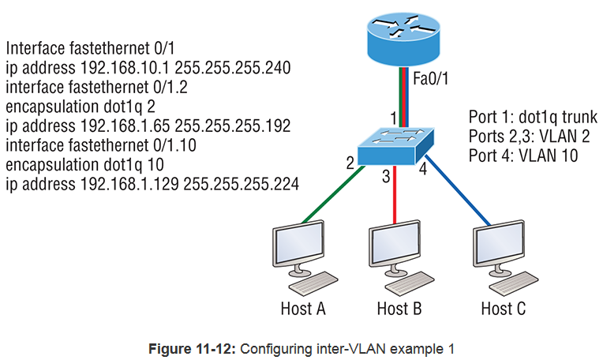
which subnets are being used?
what are the hosts' IP addresses?

Slide 23
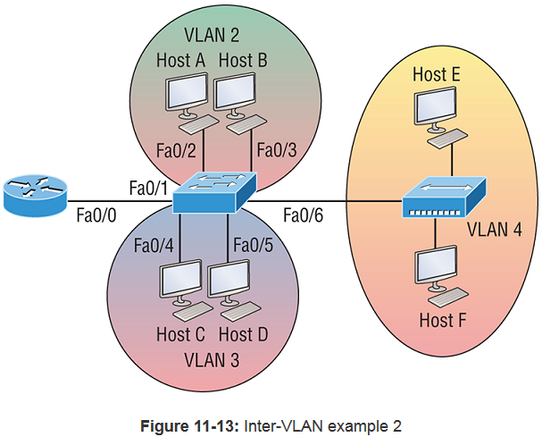
When looking at this diagram, keep in mind that these three factors are what Cisco expects you to know:
The router is connected to the switch using subinterfaces.
The switch port connecting to the router is a trunk port.
The switch ports connecting to the clients and the hub are access ports, not trunk ports.

Slide 24
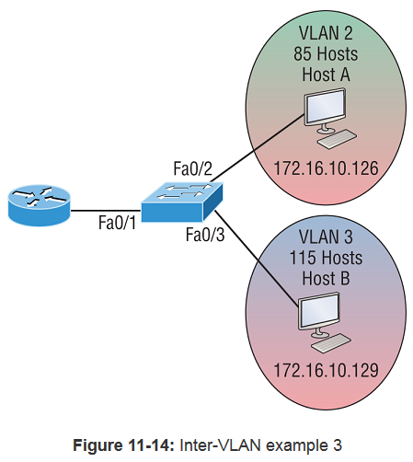
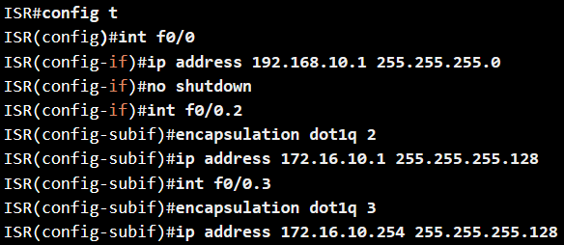
What would your router and switch configurations be based on these IP addresses?

Slide 25
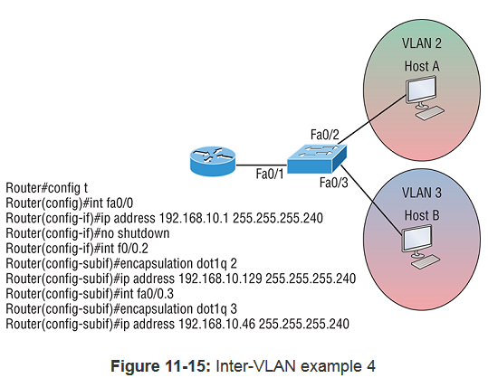
In Figure 11-15 there are two VLANs, plus the management VLAN 1. By looking at the router configuration: What's the IP address, subnet mask, and default gateway of Host A? Use the last IP address in the range for Host A's address.

Slide 26
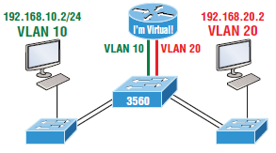
Figure 11.16: Inter-VLAN routing with a multilayer switch
config)#ip routing
S1(config)#int vlan 10
S1(config-if)#ip address 192.168.10.1 255.255.255.0
S1(config-if)#int vlan 20
S1(config-if)#ip address 192.168.20.1 255.255.255.0
Set your hosts to the IP address associated to their VLAN, and that’s all it takes!

Slide 27
Written Labs and Review Questions
Read through the Exam Essentials section together in class.
Open your books and go through all the written labs and the review questions.
Review the answers in class.
27

